Slide 1
Privacy Regulation:
Culturally Universal or Culturally Specific?
Irwin Altman
Discussion Lead : Aditya Shirode

Slide 2
ABOUT THE PAPER
Written in 1977 by Dr. I. Altman, a Social psychologist, Culture-environment researcher
Published in the ‘Journal of Social Issues’ Vol 33 No 3
As a follow-up of the 1975 article by the author about privacy as the selective control of access to the self
Notes:
From Department of Psychology, University of Utah
Privacy processes involving dialectic, optimization, and multimodal processes (which we’ll learn about in a bit)

Slide 3
HOW THE PAPER IS STRUCTURED
Theoretical model for privacy
Analysis of the cultural model
Discusses various issues, dilemmas, strategies for dealing with cultural universals defined wrt privacy
Reviews various examples
Notes:
The first section of the article summarizes a theoretical model and rationale for conceiving privacy as a cultural universal. Dilemmas, issues, and a strategy for dealing with the question of cultural universals are then discussed, followed by a review of ethnographic data related to privacy.

Slide 4
A THEORETICAL APPROACH TO PRIVACY
A dynamic dialectic boundary-control process
An optimization process
A multi-mechanism process
A privacy function
Notes:
From The environment and social behavior : privacy, personal space, territory, crowding (1975)
Optimization - a non-monotonic one (Not varying too much or too little)
Multi-mechanism - a network of behavioral mechanisms to achieve a desired level of social interactions
Privacy functions - (a) management of social interaction, (b) establishment of plans and strategies for interacting with others, and (c) development and maintenance of self-identity
Privacy as an ongoing process of controlling who has access to the self
Privacy means ‘changing boundary control’, not merely keeping others out
Privacy is a dynamic process whereby people vary in the degree to which they are accessible to others (Extreme openness to extreme closedness)
Privacy regulation is a multimodal process involving many levels of behavior and that it operates as a 'social system', not merely an environmental one
Altman believes the goal of privacy regulation is to achieve the optimum level of privacy (i.e., the ideal level of social interaction).
Level above is too much isolation; level below is too much crowding

Slide 5
CONTRIBUTIONS
A novel analysis of privacy in relationship to culture
Provides a framework emphasizing dialectical and boundary control features of privacy
Sheds an interesting light on the concept of privacy as a social psychological process
Notes:
Examines privacy as a generic process; occurs in all cultures - but differs in terms of behavioural mechanisms
Examines Ethnographic data (?) and Social relationships
Concludes - Privacy is a universal process that involves culturally unique regulatory mechanisms

Slide 6
INTRODUCTION
Answer to question posed by the title?
Privacy Regulation: Culturally Universal or Culturally Specific?
Author says - “Yes and No!”
Privacy is culturally pervasive and unique
Notes:
Title - Privacy Regulation: Culturally Universal or Culturally Specific?
Author says a paradoxical answer to the question that title poses is that both positions are correct
Privacy is culturally pervasive - process involving dynamic, dialectic, and optimization features
Privacy is culturally unique - process in terms of mechanisms used to regulate social interaction

Slide 7
ASSESSMENT - TILL NOW
Observing a culture from outside
Levels of abstraction between cultures act as ‘Yawning Truisms’ (Useless, boring truths)
Problems -
Verifying Ethnographic material
Labeling behavioral events

Slide 8
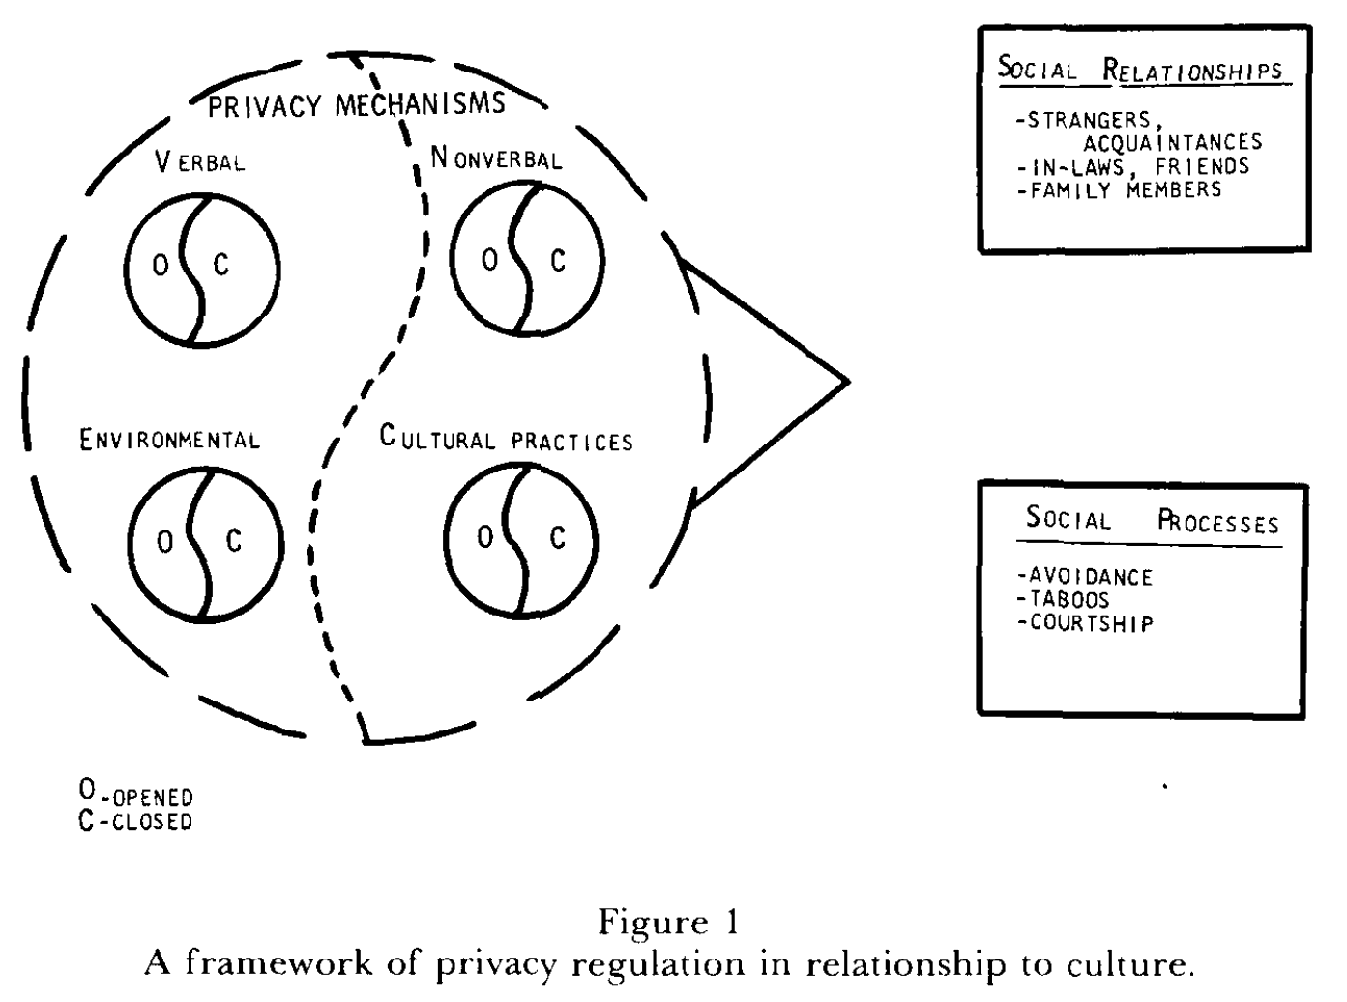
A CULTURAL APPROACH TO PRIVACY
Notes:
Small circles - Behavioral mechanisms for controlling privacy (verbal and nonverbal behavior)
The divisions within circles - dialectical notions of accessibility and inaccessibility. (Non-verbal -> openness/ closedness)
Outer superimposed circle - reflects that idea is a complex system
Concept of dialectics
Notion of Yin/yang; world is made up of opposites; this very opposition provides meaningfullness and unity to the whole
Harmony and conflict, opposite processes, provide a unity to social relationships
Also indicates a constant state of change i.e. one never permanently wishes to have contact (or to avoid contact) with others; varies with the setting and one’s current internal state
Privacy means ‘changing boundary control’, not merely keeping others out
Privacy is a dynamic process whereby people vary in the degree to which they are accessible to others (Extreme openness to extreme closedness)
The environment is both "a determinant of behavior and as an extension of behavior”

Slide 9
ASSESSMENT - AUTHOR’S APPROACH
Analyze extreme cases of privacy
Cultures with Min/Max privacy
Finding compensatory mechanisms that modulate the behavior
Analyze social relationships
Notes:
By grouping societies as high or low or present or absent on a particular behavior, one could then compare how each type of culture operated according to other areas of social interaction relevant to privacy regulation.
Cultures have a variety of customs, rules, and norms which communicate openness or closedness to others and which are readily understood by most people in a particular culture
Cultures, individuals within cultures, and groups within cultures use verbal, nonverbal, environmental, and cultural mechanisms to make themselves accessible or inaccessible to others for privacy regulation

Slide 10
CULTURES WITH APPARENTLY MINIMAL PRIVACY
Javanese culture
Unfenced bamboo homes, thin walls, no doors
Hiding emotional feelings, elaborate decorum
Notes:
(Geertz - Westin; 1967)
Outsiders freely wandered in and out, and people went from room to room without announcement
Javanese shut people out with a wall of etiquette

Slide 11
CULTURES WITH APPARENTLY MINIMAL PRIVACY
Javanese culture
Pygmies of Zaire (the Congo)
Huts with large leaves, open camps
Rearrangement, spite fences (Short-term)
Moving away for up to 2 months (Long-term)
Notes:
(Turnbull; 1961)
Northeast corner of Ituri forest
One could almost keep track of arguments, jealousies, and conflicts as the directions of the huts were rearranged
Oscillated between periods of separateness and togetherness
Regulate and pace the flow of their social interaction

Slide 12
CULTURES WITH APPARENTLY MINIMAL PRIVACY
Javanese culture
Pygmies of Zaire (the Congo)
Woleia atoll
Extensive face-to-face contact
Separately assigned work areas
Restricted areas for opposite sexes
Notes:
(Alkire; 1968)
A 5 mile long by 2.5 mile wide island in the Western Caroline Islands, South Pacific
Population of about 600
To minimize heterosexual competition and jealousies
Men and women never worked together, never danced together, hardly ate together, stayed away from each others’ specified areas, did not talk when alone
All of this to counteract the extensive physical contact generated by the small size of physical environment
Other examples-
The Ngadju Dayaks of Borneo (Miles, 1970), the Choco Indians of Panama (Faron, 1962), the !Kung Bushmen of Southwest Africa (Draper, 1973)

Slide 13
CULTURES WITH APPARENTLY MAXIMUM PRIVACY
Balinese culture
A tremendous warmth, humor, and openness
High walls, narrow doorways
Free interaction with only family and friends
Notes:
(Geertz - Westin; 1967)

Slide 14
CULTURES WITH APPARENTLY MAXIMUM PRIVACY
Balinese culture
Tuareg culture
Veil acted as controllable boundary
Men wear outer garment covering whole body
Only eyes visible through veil
Notes:
(Murphy; 1964)
Moslem nomadic pastoral people, Northern Africa
Veil is ever so slightly raised or lowered to fit various social relationships
Sensitive to slight eye movements and body posture
Other examples-
Pantelleria, Sicily, Italy (Galt; 1973)
Civilization on another planet in Asimov’s The Caves of Steel

Slide 15
A CULTURAL APPROACH TO PRIVACY
Notes:
Concept of dialectics
Notion of Yin/yang; world is made up of opposites; this very opposition provides meaningfullness and unity to the whole
Harmony and conflict, opposite processes, provide a unity to social relationships
Also indicates a constant state of change i.e. one never permanently wishes to have contact (or to avoid contact) with others; varies with the setting and one’s current internal state
The environment is both "a determinant of behavior and as an extension of behavior”

Slide 16
ASSESSING SOCIAL RELATIONSHIPS
Privacy examined for three types of bonds -
Peripheral (Strangers, acquaintances, colleagues)
Extensive (In-laws)
Close (Husband-Wife, Parents-Children)
Notes:
Argyle, Henderson, and Furnham (1985)
A study of 33 social rules, found that the two of the three rules that were widely applicable across 22 types of social relationships were privacy-related:
respecting other's privacy, and not discussing what one is told in confidence. The third rule was looking others in the eye during conversations.

Slide 17
RELATIONSHIPS WITH STRANGERS
African Pygmies <> Bantu Negroes
Lapps of Northern Europe
Australian Aborigines
Chinese families in Malaysia
Ngadju Dayaks of Borneo
Notes:
African Pygmies <-> Bantu Negroes (Turnbull; 1961)
Feast together after a major meat kill; Beating at gambling game to make these irritant guests leave camp
Lapps of Northern Europe (Paine; 1970)
Entering a tent without any preliminary action; feigning falling asleep to indicate unwantedness
Australian Aborigines (Peterson; 1975)
Visitors remained at fringes of encampment, until an escort was sent to welcome them
Chinese families in Malaysia (Anderson; 1972)
Lived together; Had strong taboos for entering personal spaces of other families (even looking into), maintenance of neutral and unemotional relationships with other families
Ngadju Dayaks of Borneo (Miles; 1970)
Multifamily units; Separate sleeping areas and possessions
So some regulated interaction in advance; some altered the pace following its initiation

Slide 18
RELATIONSHIPS WITH IN-LAWS
Yuma Indians of SouthEastern California
Rural groups in Thailand
Co-wives in Gussi-Kipsigis-Luo African societies (Polygamy)
Notes:
Yuma Indians of southeastern California (Bee; 1963)
Minimal joking, infrequent positive emotional expressions
Rural groups in Thailand (Tambiah; 1969)
Different entrance for son-in-law, different sleeping area
Co-wives (Polygamy) Gussi-Kipsigis-Luo African societies (LeVine, 1962)
Shared common spaces; fences separating huts; lived at a distance from each other
The wives accused each other of sorcery and witchcraft; but the amount was inversely proportional to distance
Greater the forced contact between in-laws or those in analogous relationships, the more prevalent the mechanisms by which avoidance was achieved
So simultaneous presence of contact and noncontact between in-laws

Slide 19
RELATIONSHIPS WITHIN FAMILIES
Observation about 50 societies
Adolescent initiation rituals
Kwama people of New Guinea
Relationship between child and mother-father
Notes:
About 50 societies - Adolescent initiation rituals to break off the high social contact between a mother and a child a year after childbirth (Whiting, Kluckhohn, and Anthony; 1958)
Cultures with high social contact between a mother and a young child also had mechanisms to break off that contact in later years
Kwama people of New Guinea (Whiting, Kluckhohn, and Anthony; 1958)
Child remained close to mother for 2-3 years; changed abruptly at the time of weaning

Slide 20
MEHINACU CULTURE
Apparently minimal privacy
Communal houses around a circular plaza
Non-private living arrangements
Secret paths and clearings
Extended stay away from society
Systematic Isolation
Notes:
Mehinacu Indians, a tribal group from Central Brazil
(Gregor and Roberts; 1970, 1974)
Long, straight paths; everyone could be seen as they moved about
Everyone knew a great deal about everyone else’s whereabouts
It seems they have little privacy in traditional sense
Permissible to leave the village for a few days
Strong norms against exposing others’ misconduct
Systematic isolation -
Right after birth, with parents, for weeks
Then alone for 1-1.5 years
Then around age of 9-10
They were taught to speak quietly, to refrain from play, and to avoid emotional displays
On death of spouse, for men who tried to become religious leaders

Slide 21
MEHINACU CULTURE (CONTINUED..)
Social relationships
Neighbors
Avoided entering others’ areas, erected partitions during periods of seclusion
Notes:
Lived in communal dwellings but avoided entering others’ areas; they also erected partitions during periods of seclusion

Slide 22
MEHINACU CULTURE (CONTINUED..)
Social relationships
Peripheral
In-laws
No touching another’s sleeping hammock, avoided meeting in entranceways, aversion of eyes when crossing, spoke briefly
Notes:
Son-in-law approached father-in-law only through wife

Slide 23
MEHINACU CULTURE (CONTINUED..)
Social relationships
Peripheral
Extensive
Family
A variety of behavioral mechanisms to portray to changing quality of the bond
(Publicly bathing together, Walking side-by-side, Position of sleeping hammocks, Eating from a common bowl)
Notes:
Cultures seem to have developed universally a variety of mechanisms for regulating interaction between strangers, acquaintances, in-laws, or family members
These mechanisms enable people to shut themselves off from others or to be accessible to others.
Temporal simultaneity/longer cyclical periods
Privacy is controlled by a variety of behavioral mechanisms that may be culturally unique and adapted to the particular circumstances of a society

Slide 24
CONCLUSION
Conceptualized privacy as a complex phenomenon
Observed that privacy has a cultural context
Posited that privacy is not a simple on-off process, but has many intertwined complex physical and environmental aspects involved
Notes:
Specifically, privacy regulation is a cultural universal but mechanisms to control it are culturally specific
Suggests -
(a) People in all cultures engage in the regulation of social interaction
(b) The behavioral mechanisms are unique to the particular physical, psychological, and social circumstances of a culture

Slide 25
PROS/CONS
Explores privacy as a phenomenon constructed in a social life in a unique way
Dual natured view gives a different perspective
Inferences dependent on interpretation
Examples are limited in diversity; lack of solid proof
Notes:
Drawbacks highlighted by author-
Selective bias in case selection
Imposition of an ethnocentric frame of reference on other cultures
Non representativeness of cases
Incomplete ethnographies
Iinaccurate labeling of cultural practices

Slide 26
RELEVANCE
Legal/ Policy context
The notion of privacy governs the idea of how much information should be disclosed to others
New ways for thinking about privacy in this virtual age with dynamic social boundaries
Notes:
Policy solutions cannot simply follow a fixed set of global standards; because privacy practices are culturally specific
Iterates that Privacy is more of a process than a state
Internet privacy policy may benefit from acknowledging that “cultures do share a minimal conception of privacy and all have some rich conception of it as well”
In digital world, individuals are challenged to understand and identify a new set of boundaries in order to negotiate privacy in these spaces

Slide 27
DISCUSSION
Online/ Offline/ Hidden status feature
Multiple online personas
Street view
Are we doing a good job respecting everyone’s preference in privacy policies?
How much should one focus on these privacy implications while designing something?
Notes:
Design rules - Scott Lederer, et al., Personal Privacy through Understanding and Action: Five Pitfalls for Designers (2004)
Privacy by design
From Buzz to Google+
Ads- are we violating users’ right to privacy?

Slide 28
FUTURE RESEARCH
?
What should be the default privacy features of SNS and should they differ according to country/ culture/ age
Defining default privacy oriented design principles

Slide 29
REFERENCES
Altman, Irwin, and Martin Chemers. Culture And Environment. 1980. Print.
Margulis, Stephen T. 'Privacy As A Social Issue And Behavioral Concept'. Journal of Social Issues 59.2 (2003): 243-261. Web.
Altman, Irwin. The Environment and Social Behavior: Privacy, Personal Space, Territory, Crowding. Monterey, Calif: Brooks/Cole Pub. Co, 1975. Print.
Notes:
https://iapp.org/media/pdf/events_and_programs/Privacy%20by%20Design-A%20Counterfactual%20Analysis.pdf

Slide 30
Next Presentation >>
A Taxonomy Of Privacy (D. Solove)
Presenter - Venkatesh Sambandamoorthy

